Slide 1
Analysis of Car Price
Project done by
CH.Aravind Kumar
K.Harish
Harshith Bejjam
Siva Sai Korada

Slide 2
Problem Statement :
Every one dreams of buying a car...so how do we choose that is perfect for us?
Our vision is to construct an analysed report to consumer,car manufacturer such that consumers can have easy and complete access over their ownership content with detailed specifications and price analysis and give people the tools to find insights
Report that helps users buy best cars that are right for them in their Budget

Slide 3
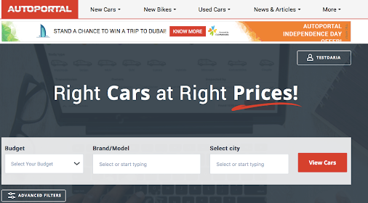
Website Used:

Slide 4


Structure

Slide 5
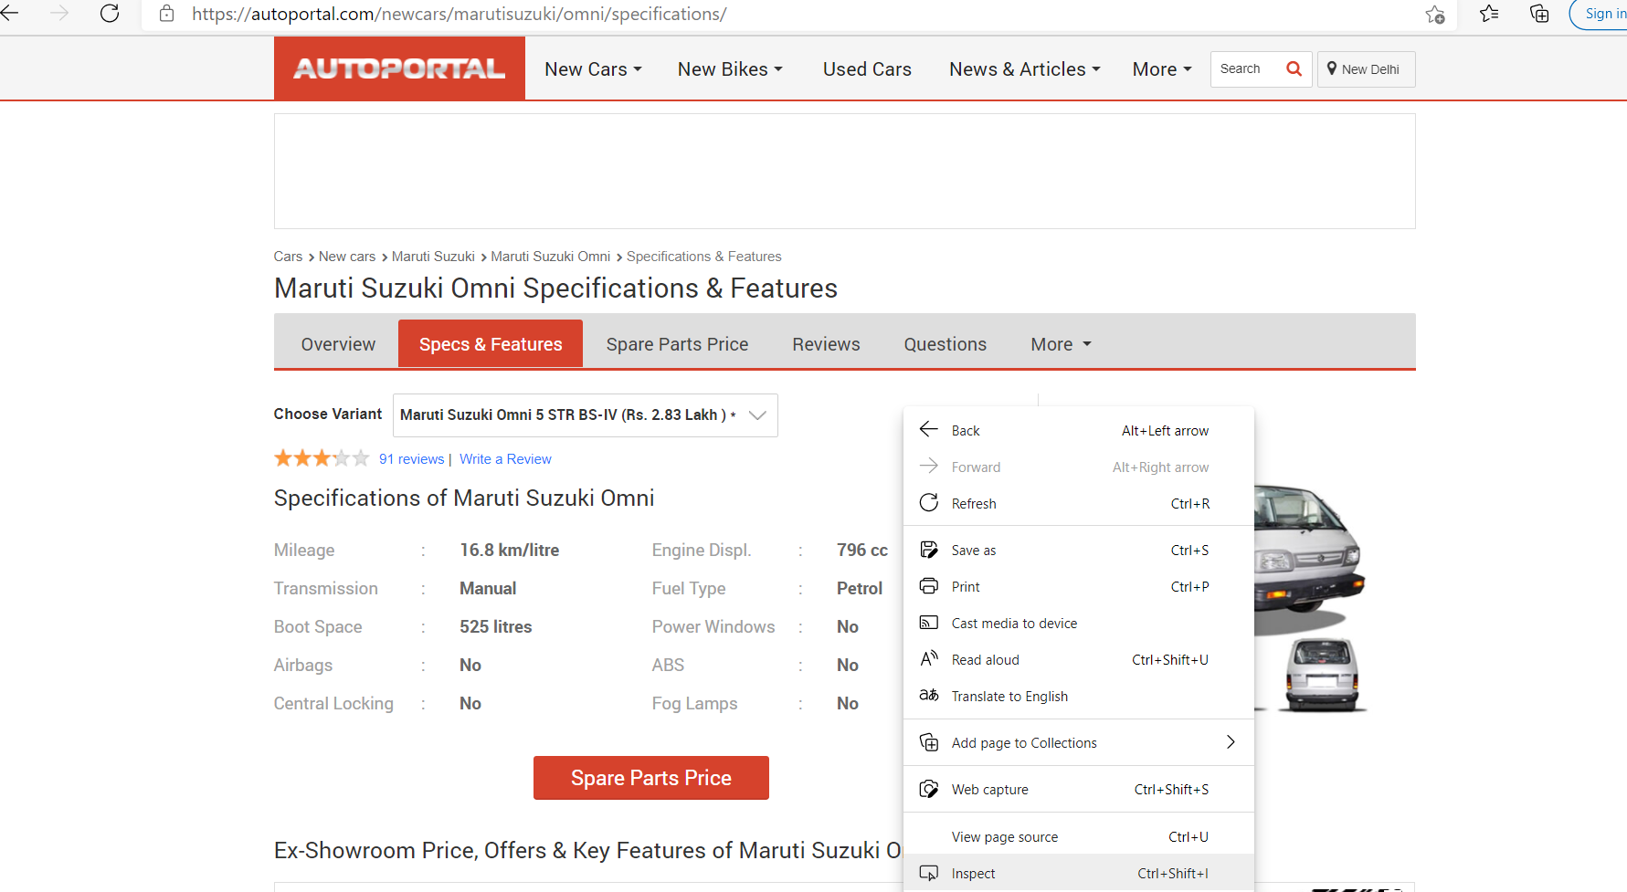
Inspecting the Auto Portal Website :

Slide 6
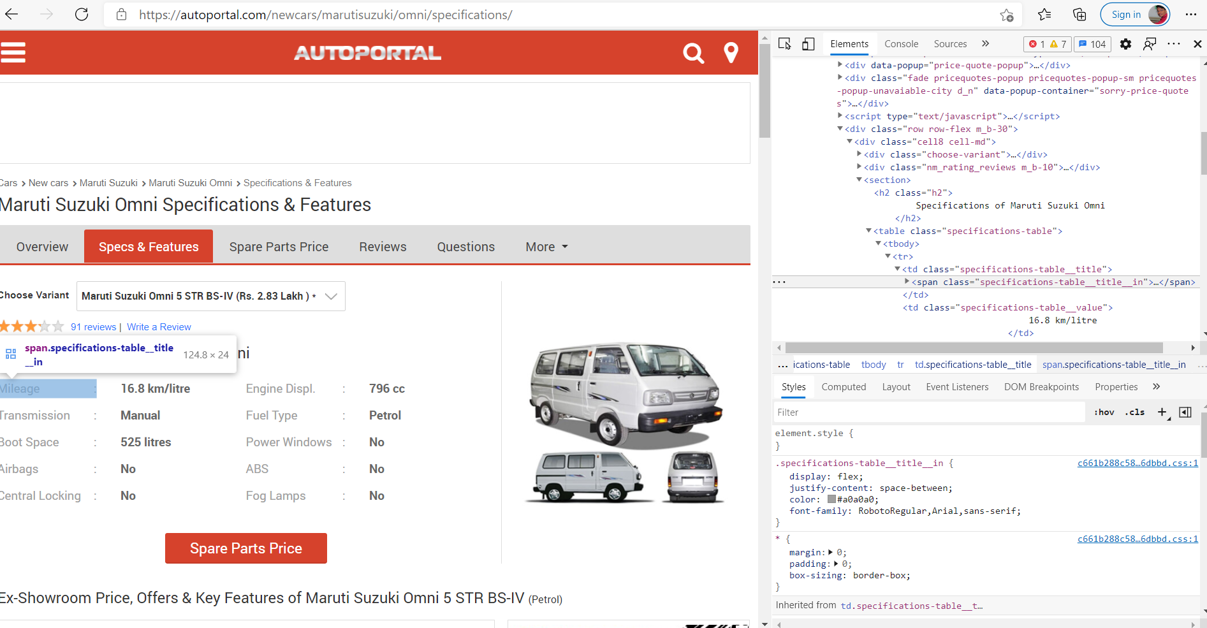
Extracting the HTML Tags for our requires Features :

Slide 7
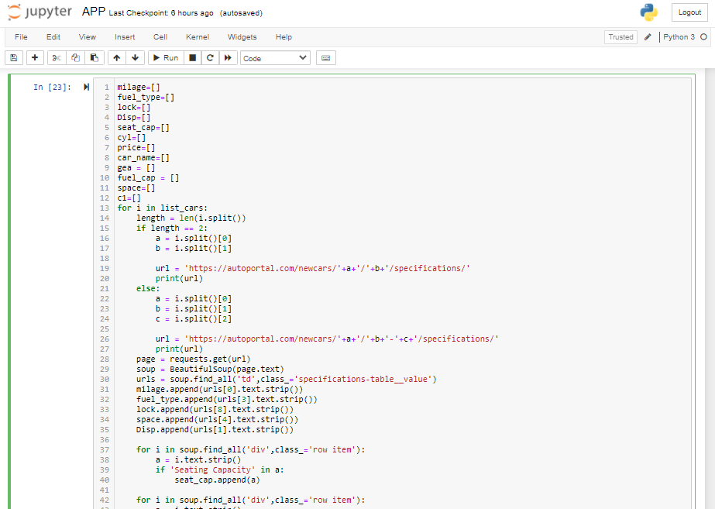
Code to Scrap the Data :

Slide 8
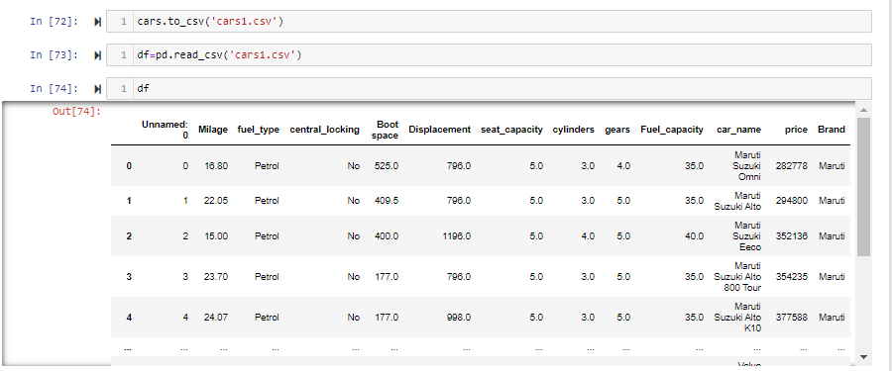
Converting Data Frame to CSV

Slide 9


Slide 10
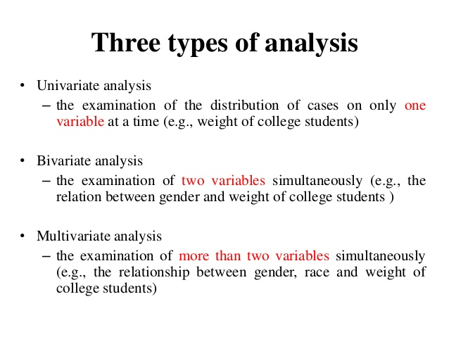

Slide 11
Univariate Analysis:
It takes data, summarizes that data and finds patterns in the data.
“Uni” means “one”, so in other words your data has only one variable.
Count plot
Histogram plot
Bar plot
Box plot

Slide 12
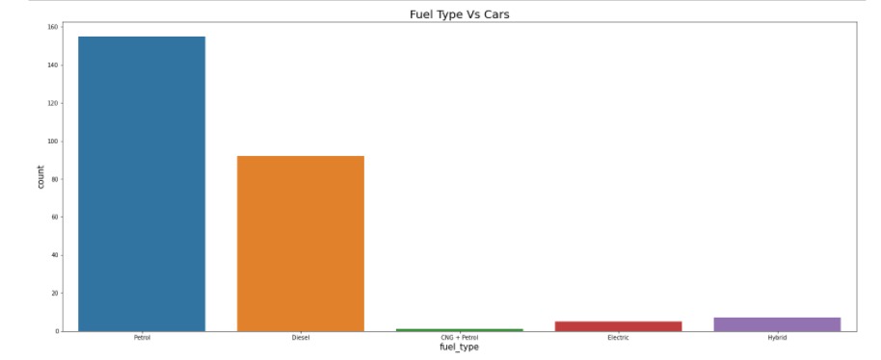
Count Plot:
Observation :
Most No. of cars are 'Petrol' as Fuel type.
Only one car is having 'CNG+Petrol' as Fuel type.
'Electric' and 'Hybrid' Fuel types are also having less No. of cars compared 'Petrol' and 'Diesel‘.

Slide 13
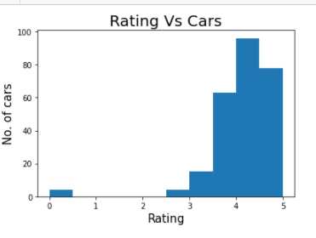
Histogram Plot:
Observation :
Most of the cars are having high rating between 4 and 5.
The cars with low rating are around 0-1 and 2-3.

Slide 14
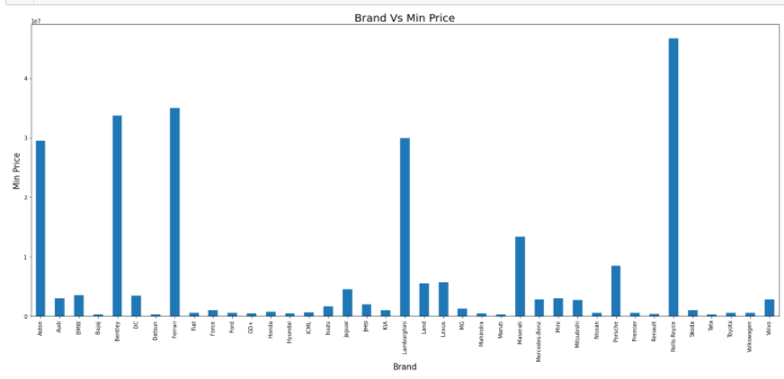
Bar Plot :
Observation:
From the data Rolls-Royce has the highest Price.
From the data Bajaj has the lowest Price of Rs.2,63,000.

Slide 15
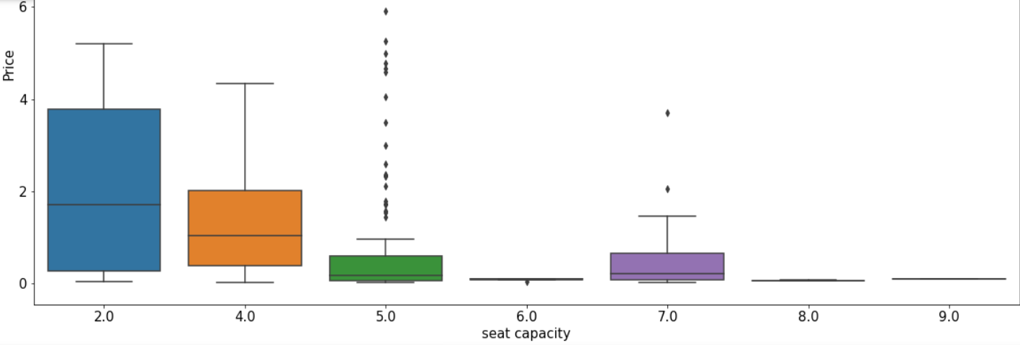
Box Plot :

Slide 16
Bivariate Analysis:
Bivariate analysis means the analysis of bivariate data.
It is the analysis of exactly two variables.
Scatter Plot
Joint Plot
Strip Plot
Bar Plot

Slide 17
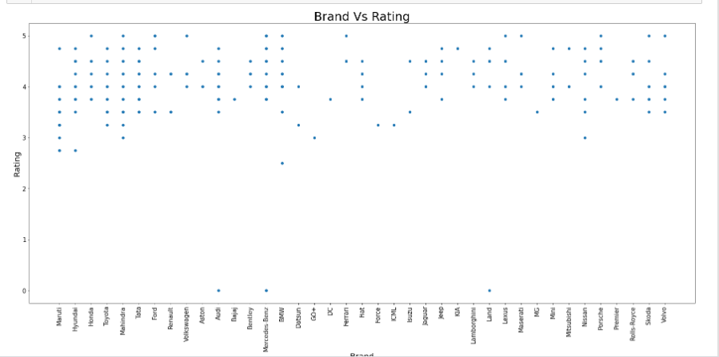
Scatter Plot:
Observation:
From the above plot 12 Brands are with highest rating of 5 and 3 brands are with lowest rating of 0.

Slide 18
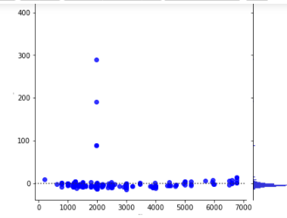
Joint Plot:
Observations:
Cars of displacement between 1000-2000 are having the highest milage.
Cars of displacement between 5000-6000 are having the lowest milage.

Slide 19
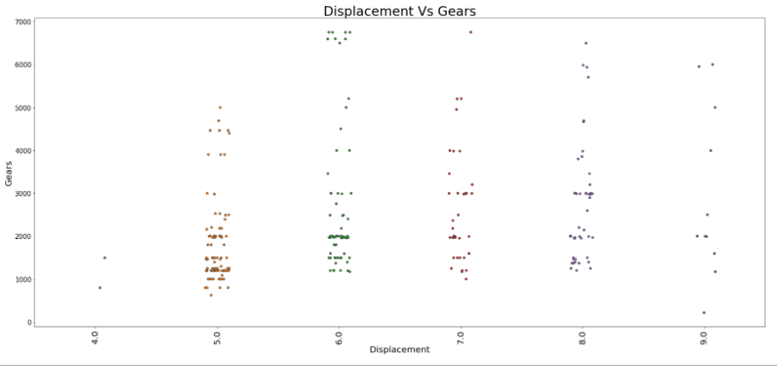
Strip Plot :
Observations:
The cars with displacement above 5000 have more than 6 gears and cars with displacement less than 2000 have at least 4 gears.

Slide 20
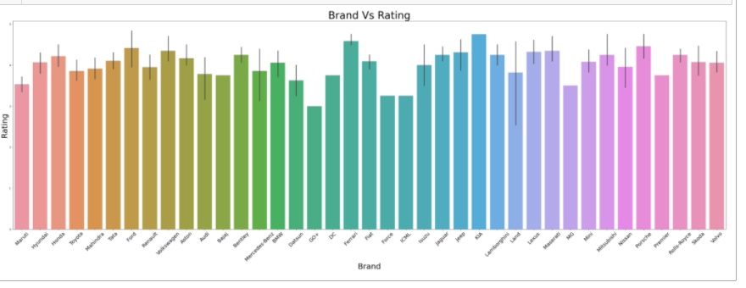
Bar Plot:
Observations:
KIA is having the highest rating
Datsun GO+ is having the lowest rating

Slide 21
Multivariate:
Multivariate analysis is used to study more complex sets of data
Cat Plot
Heat Map

Slide 22
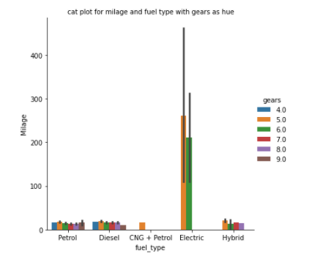
Cat Plot:
Observations:
The cars with "Electric" fuel type has more mileage with 5 and 6 gears and cars with "Diesel" fuel type with 9 gears has low mileage.

Slide 23
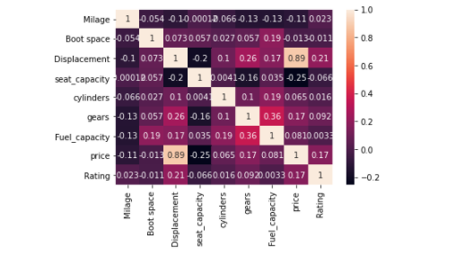
Heat Map:
Observations:
From the correlation the above heat map it can be observed that Displacement of the cars certainly has effect on mileage of the cars. So we can conclude that mileage of the car depends on its displacement.

Slide 24
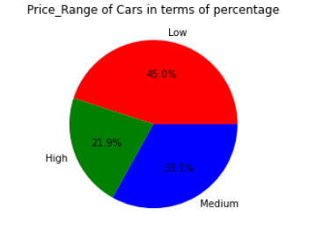
Pie Chart:
Observation:
From the Pie Plot we can see that there are most number of cars are less than 20 lakhs.
There are less number of cars with price more than 1 crore.

Slide 25
Conclusion
A successful detailed analyzed report of cars with specifications and prices is done by using EDA tools and thereby ensuring the consumer choose the best car in their Budget.

Slide 26

THANK YOU

